Slide 1
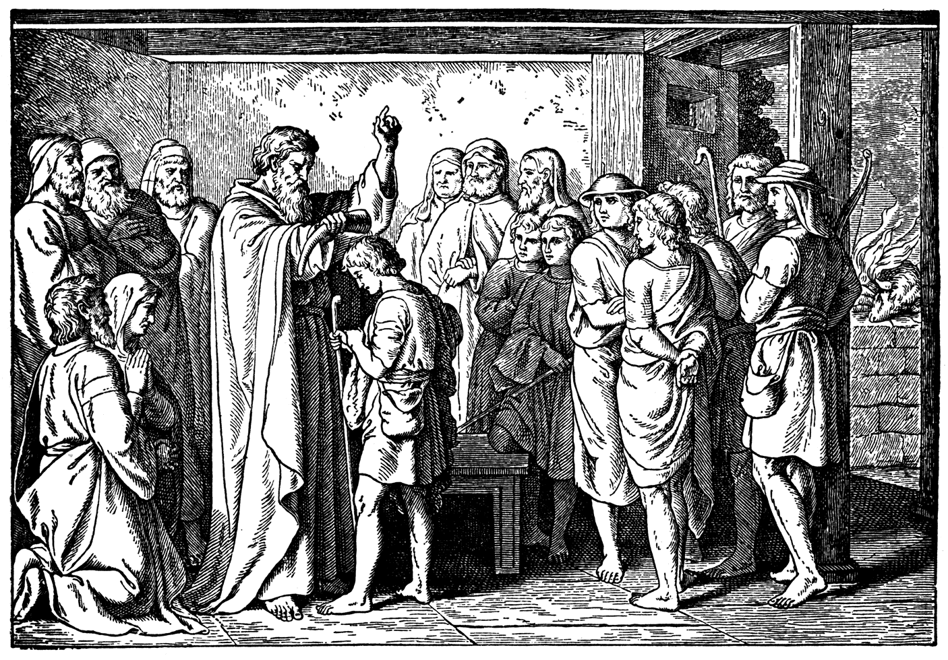
God Provides Himself a King – Part 2

Slide 2
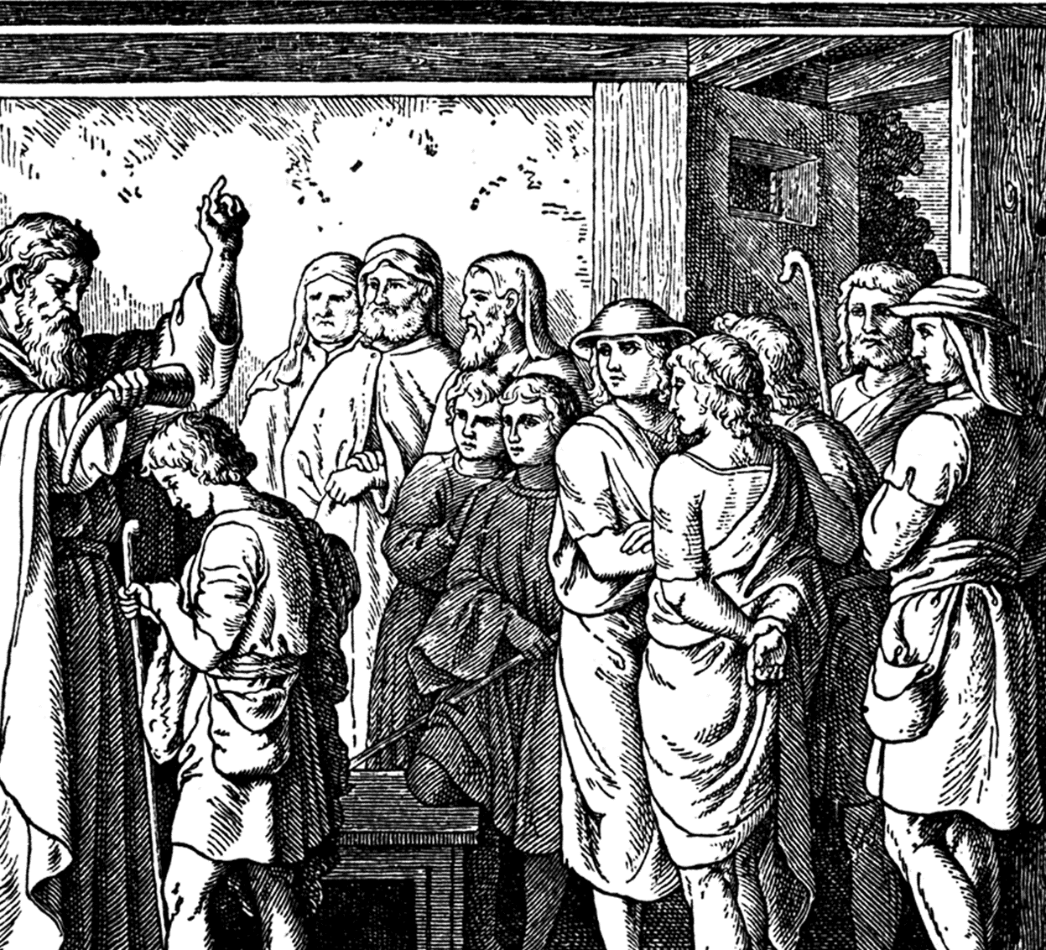
DAVID
“anointed” – type of Christ.
Moving forward in the power of the Spirit.

Slide 3
John 15:5 I am the vine, ye are the branches: He that abideth in me, and I in him, the same bringeth forth much fruit: for without me ye can do nothing.

Slide 4
Psalm 119:34 Give me understanding, and I shall keep thy law; yea, I shall observe it with my whole heart.

Slide 5
Psalm 119:97 O how love I thy law! it is my meditation all the day.

Slide 6
1 Samuel 13:13-14 And Samuel said to Saul, Thou hast done foolishly: thou hast not kept the commandment of the LORD thy God, which he commanded thee: for now would the LORD have established thy kingdom upon Israel for ever. 14 But now thy kingdom shall not continue: the LORD hath sought him a man after his own heart, and the LORD hath commanded him to be captain over his people, because thou hast not kept that which the LORD commanded thee.

Slide 7
Acts 13:22 And when he had removed him, he raised up unto them David to be their king; to whom also he gave testimony, and said, I have found David the son of Jesse, a man after mine own heart, which shall fulfil all my will.

Slide 8
2 Samuel 7:15 But my mercy shall not depart away from him, as I took it from Saul, whom I put away before thee.

Slide 9
Luke 16:10 He that is faithful in that which is least is faithful also in much: and he that is unjust in the least is unjust also in much.
Matthew 25:21 His lord said unto him, Well done, thou good and faithful servant: thou hast been faithful over a few things, I will make thee ruler over many things: enter thou into the joy of thy lord.

Slide 10
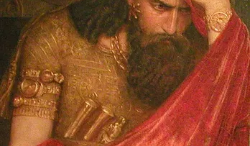
Saul.
Notice that the Text is dealing with 2 different spirits.
Why is the evil spirit FROM the Lord?

Slide 11
Job 1:12 And the LORD said unto Satan, Behold, all that he hath is in thy power; only upon himself put not forth thine hand. So Satan went forth from the presence of the LORD.

Slide 12
1 Timothy 4:1 Now the Spirit speaketh expressly, that in the latter times some shall depart from the faith, giving heed to seducing spirits, and doctrines of devils;

Slide 13
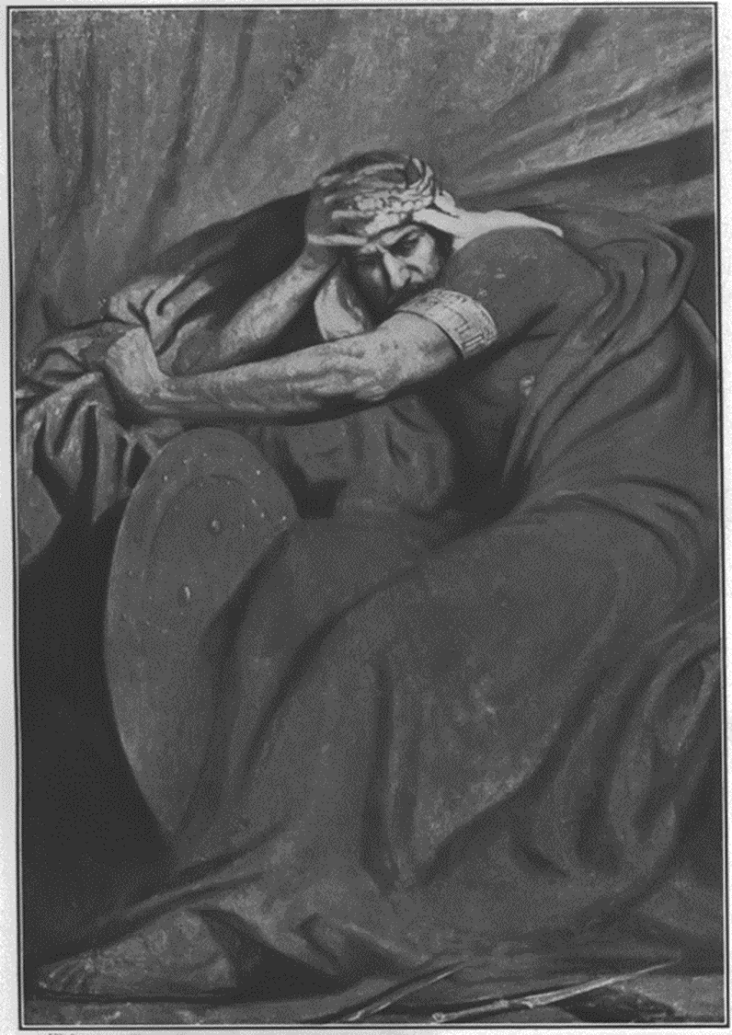
You are submitted to on of two authorities.

Slide 14
Genesis 2:16-17 16 And the LORD God commanded the man, saying, Of every tree of the garden thou mayest freely eat: 17 But of the tree of the knowledge of good and evil, thou shalt not eat of it: for in the day that thou eatest thereof thou shalt surely die.

Slide 15
2 Corinthians 4:1-4 1 Therefore seeing we have this ministry, as we have received mercy, we faint not; 2 But have renounced the hidden things of dishonesty, not walking in craftiness, nor handling the word of God deceitfully; but by manifestation of the truth commending ourselves to every man's conscience in the sight of God. 3 But if our gospel be hid, it is hid to them that are lost: 4 In whom the god of this world hath blinded the minds of them which believe not, lest the light of the glorious gospel of Christ, who is the image of God, should shine unto them.

Slide 16
John 8:42-45 42 Jesus said unto them, If God were your Father, ye would love me: for I proceeded forth and came from God; neither came I of myself, but he sent me. 43 Why do ye not understand my speech? even because ye cannot hear my word. 44 Ye are of your father the devil, and the lusts of your father ye will do. He was a murderer from the beginning, and abode not in the truth, because there is no truth in him. When he speaketh a lie, he speaketh of his own: for he is a liar, and the father of it. 45 And because I tell you the truth, ye believe me not.

Slide 17
1 Corinthians 15:21-22 21 For since by man came death, by man came also the resurrection of the dead. 22 For as in Adam all die, even so in Christ shall all be made alive.
1 Corinthians 15:45 And so it is written, The first man Adam was made a living soul; the last Adam was made a quickening spirit.

Slide 18
Matthew 15:7-9 7 Ye hypocrites, well did Esaias prophesy of you, saying, 8 This people draweth nigh unto me with their mouth, and honoureth me with their lips; but their heart is far from me. 9 But in vain they do worship me, teaching for doctrines the commandments of men.

Slide 19
Jeremiah 42:19-22 19 The LORD hath said concerning you, O ye remnant of Judah; Go ye not into Egypt: know certainly that I have admonished you this day. 20 For ye dissembled in your hearts, when ye sent me unto the LORD your God, saying, Pray for us unto the LORD our God; and according unto all that the LORD our God shall say, so declare unto us, and we will do it. 21 And now I have this day declared it to you; but ye have not obeyed the voice of the LORD your God, nor any thing for the which he hath sent me unto you. 22 Now therefore know certainly that ye shall die by the sword, by the famine, and by the pestilence, in the place whither ye desire to go and to sojourn.

Slide 20
Matthew 7:22-23 22 Many will say to me in that day, Lord, Lord, have we not prophesied in thy name? and in thy name have cast out devils? and in thy name done many wonderful works? 23 And then will I profess unto them, I never knew you: depart from me, ye that work iniquity.

Slide 21
2 Timothy 3:1-7 1 This know also, that in the last days perilous times shall come. 2 For men shall be lovers of their own selves, covetous, boasters, proud, blasphemers, disobedient to parents, unthankful, unholy, 3 Without natural affection, trucebreakers, false accusers, incontinent, fierce, despisers of those that are good, 4 Traitors, heady, highminded, lovers of pleasures more than lovers of God; 5 Having a form of godliness, but denying the power thereof: from such turn away. 6 For of this sort are they which creep into houses, and lead captive silly women laden with sins, led away with divers lusts, 7 Ever learning, and never able to come to the knowledge of the truth.

Slide 22
Matthew 7:15-20 15 Beware of false prophets, which come to you in sheep's clothing, but inwardly they are ravening wolves. 16 Ye shall know them by their fruits. Do men gather grapes of thorns, or figs of thistles? 17 Even so every good tree bringeth forth good fruit; but a corrupt tree bringeth forth evil fruit. 18 A good tree cannot bring forth evil fruit, neither can a corrupt tree bring forth good fruit. 19 Every tree that bringeth not forth good fruit is hewn down, and cast into the fire. 20 Wherefore by their fruits ye shall know them.

Slide 23
Psalm 119:162-168 162 I rejoice at thy word, as one that findeth great spoil. 163 I hate and abhor lying: but thy law do I love. 164 Seven times a day do I praise thee because of thy righteous judgments. 165 Great peace have they which love thy law: and nothing shall offend them. 166 LORD, I have hoped for thy salvation, and done thy commandments. 167 My soul hath kept thy testimonies; and I love them exceedingly. 168 I have kept thy precepts and thy testimonies: for all my ways are before thee.

Slide 24
God Provides Himself a King

